Slide 1
A Pragmatic Approach to Stats and R
Jack

Slide 2
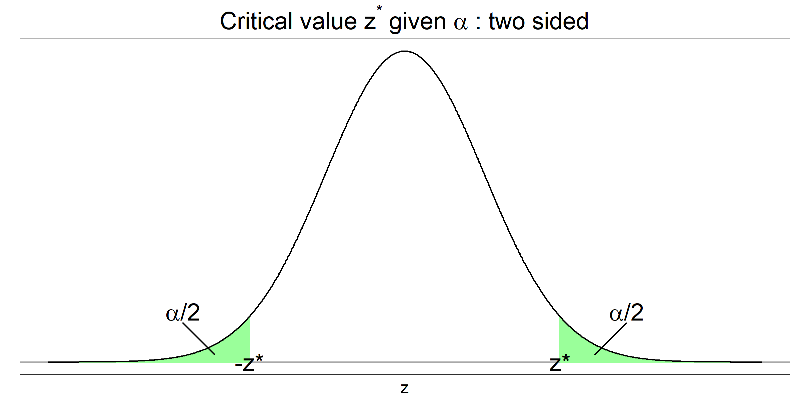
Everyone is talking about their significant other
But what is your cutoff for significance????

Slide 3
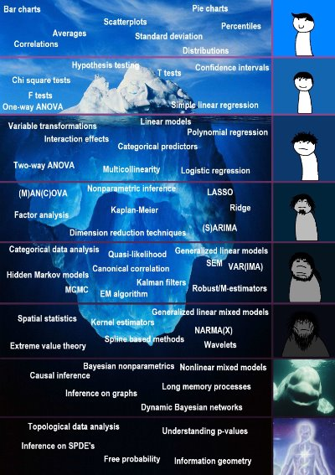
Disclaimer
There can be a lot of nuance in stats but this should be correct for you most of the time

Slide 4

Outline
What is R?
Where to get more help
Steps to finding what analysis to do
How to prep your data for R
Misc additional info
Link to my Github

Slide 5
Alternatives: Prism, SPSS, Excel
Dependent on a license, currently for free
The statistics are all done via drop down menus
You cannot format your data in the software
need to do in excel and needs weird formats
Easy to make professional graphs (Prism only)
Hard to modify to what you need
If what you need isn't in the software then you're out of luck

Slide 6

R is an open source free statistics program

Slide 7
Good sources of more stats info
Easy to understand basic stats: Welcome to Statology.org
If not covered there: Statistics How To: Elementary Statistics for the rest of us!
From one of the most famous R developers:
R for Data Science (2e)
For R help
Many subreddits for R help r/rstats, r/rstudio, r/rlanguage
Google your error
Claude AI and Github CoPilot AI

Slide 8
R YouTube tutorials
R Tutorial For Beginners 2022 | R Programming Full Course In 7 Hours | R Tutorial | Simplilearn until the Dataviz section

Slide 9
Steps to analysis
What question are you asking?
What kind of outcome variable are you looking for?
What kind of input variables do you have?
Special tests
Survival modeling (Time to event data)

Slide 10
What question are you asking?
My variables have a relationship with my outcomes
Ex: Lower hemoglobin is related to having a GIB
Regression for correlation
I have two (or more) populations and I believe that they are distinctly different
Ex: Patients with Afib have more strokes than patients without Afib
T-test or equivalent (hypothesis testing)
I'm looking at the time it takes until an event happens
See survival modeling
I have repeatedly measured something in patients and I want to see how that this measure changes over time w/ respect to my outcome
This is panel data and this is hard

Slide 11
What question are you asking?
My variables have a relationship with my outcomes
Ex: Lower hemoglobin is related to having a GIB
Regression for correlation
I have two (or more) populations and I believe that they are distinctly different
Ex: Patients with Afib have more strokes than patients without Afib
T-test or equivalent (hypothesis testing)
I'm looking at the time it takes until an event happens
See survival modeling
I have repeatedly measured something in patients and I want to see how that this measure changes over time w/ respect to my outcome
This is panel data and this is hard

Slide 12
Regression Rules
Observations (patients) must outnumber input variables
Variables should not be related to one another (multicollinearity)

Slide 13
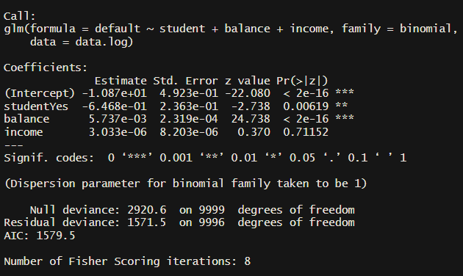
Regression Outputs
Estimate is your coefficients NOT your odds ratios
Significance codes:
0 ‘***’ 0.001 ‘**’ 0.01 ‘*’ 0.05 ‘.’ 0.1 ‘ ’ 1
Your P values
Similar to an R² but lower is better

Slide 14
Outcomes: Categorical
Logistic regression if you have a binary outcome
IBD/no IBD, MI/no MI
Multinomial regression if you have more than two categories
Predicting NYHA heart failure classification, COPD GOLD Staging
Requires different R package, not yet coded

Slide 15
Outcomes: Continuous
Linear regression
Assumes a linear relationship between your variables and outcome
Volume of urine output after diuretic dose
Change in SBP or HR

Slide 16
Outcomes: Count
Poisson regression
Ex: Number of seizures after presenting for breakthrough seizure
Number of bowel movements after laxative
Number of episodes of urination (But not amount)

Slide 17
Regression - What kind of input variables do you have?
For regression, the code is only for generalized linear models so it doesn't matter

Slide 18
What question are you asking?
My variables have a relationship with my outcomes
Ex: Lower hemoglobin is related to having a GIB
Regression for correlation
I have two (or more) populations and I believe that they are distinctly different
Ex: Patients with Afib have more strokes than patients without Afib
T-test or equivalent (hypothesis testing)
I'm looking at the time it takes until an event happens
See survival modeling
I have repeatedly measured something in patients and I want to see how that this measure changes over time w/ respect to my outcome
This is panel data and this is hard

Slide 19
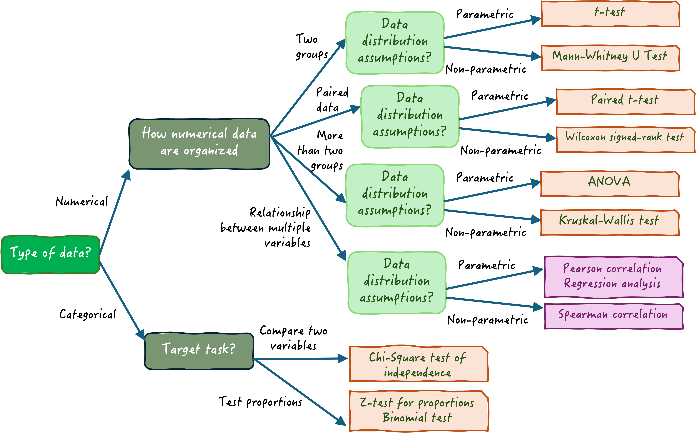
Diff in means - What kind of input variables do you have?
Choosing the Right Statistical Test: A Decision Tree Approach

Slide 20
Testing difference in means – Continuous outcomes
Two groups: T-test or Mann Whitney U Test (non-parametric)
Depends on normality, discussed later under input variables
More than two groups or want to adjust for other variables
ANOVA or variant

Slide 21
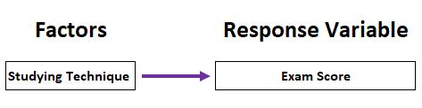
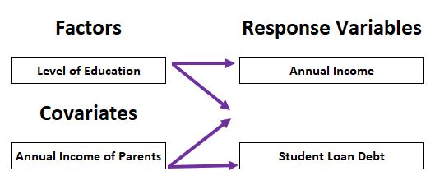
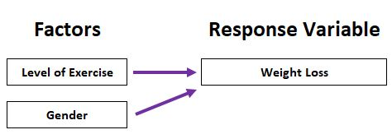
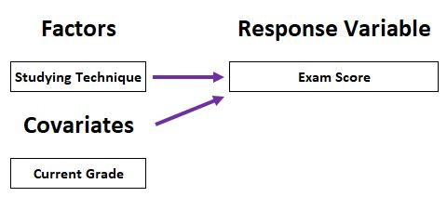
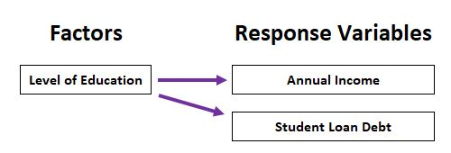
ANOVA, MANCOVA, ANCOVA, oh my!
ANOVA
Two-way ANOVA
MANCOVA
ANCOVA
MANOVA
The Differences Between ANOVA, ANCOVA, MANOVA, and MANCOVA

Slide 22
Testing difference in means – Categorical outcomes
Two groups:
One group has less than 10, Fischer's exact test
Larger sample sizes Chi squared test
 | Male | Female
Diabetic | 5 | 34
Non-diabetic | 45 | 50

Slide 23
Special notes
Use a two tailed t-test if you are looking for a difference between your two groups, use a one tailed if you are ONLY expecting a directional difference between your groups
Ex: One tailed t-test comparing LVEF in patients pre/post MI (this would also be paired)
A paired t-test is when samples in one group correspond to samples in another
Ex: a twin study, looking at patients pre/post some event

Slide 24
What question are you asking?
My variables have a relationship with my outcomes
Ex: Lower hemoglobin is related to having a GIB
Regression for correlation
I have two (or more) populations and I believe that they are distinctly different
Ex: Patients with Afib have more strokes than patients without Afib
T-test or equivalent (hypothesis testing)
I'm looking at the time it takes until an event happens
See survival modeling
I have repeatedly measured something in patients and I want to see how that this measure changes over time w/ respect to my outcome
This is panel data and this is hard

Slide 25
Survival Modeling – type of censoring
Generally 3 types
Uncensored
Study period contains the beginning and end of measurement of interest for all patients
Ex: Time to first blood work in study population of a country with universal EMR
Left censored
Study participants were at risk for event before study measurement began and you're unsure when
Not usually an issue for clinical trials
Right censored
Study period ends before all patients experience the event or are lost to follow-up
Ex: Almost all clinical trials, survival after cancer diagnosis, time to scope after admission for GIB, etc

Slide 26
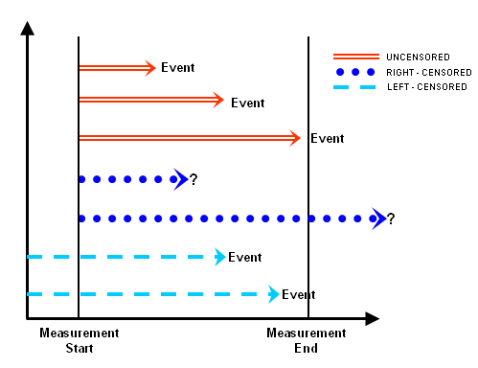
Types of censoring
Reference

Slide 27
Two most common types of modeling
Kaplan Meier curve
Not adjusted for other variables, minimal assumptions
Can have multiple groups
Cox proportional hazards model
Makes multiple assumptions, testing of these assumptions is in the code
Can adjust for other variables
You get hazard ratios from this model
Don't try to graph it and wasn't developed for prediction

Slide 28
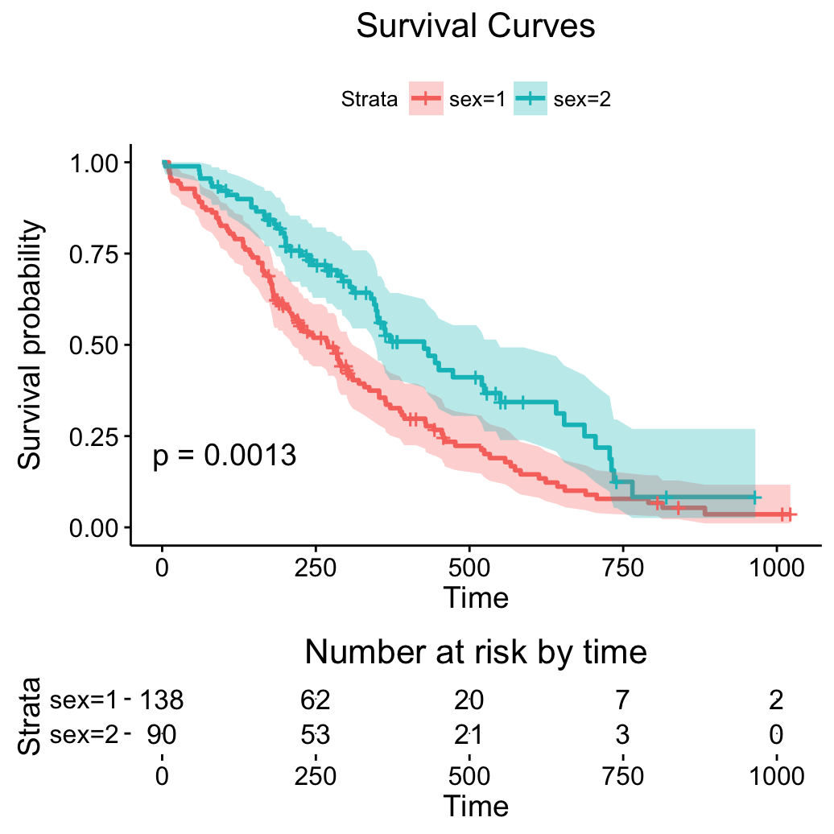
Kaplan Meier Output
A graphical representation of 95% CI
You want this under 0.05
Number at risk over time (removes both events and censors)

Slide 29
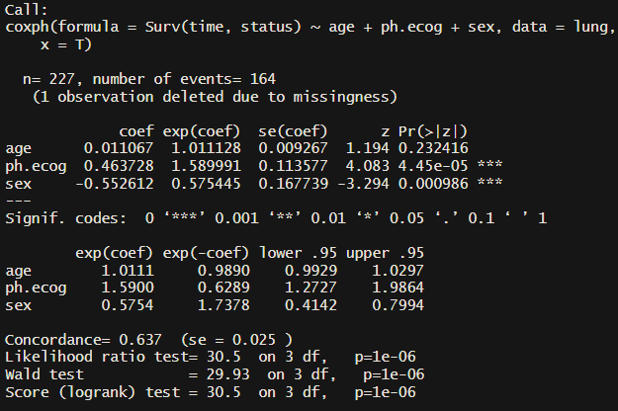
Cox Proportional Hazards Model Outputs
Exp(coef) is your odds/hazard ratios
Significance codes:
0 ‘***’ 0.001 ‘**’ 0.01 ‘*’ 0.05 ‘.’ 0.1 ‘ ’ 1
Your P values
Your hazard ratios
Similar to an R²
but for survival

Slide 30
Survival modeling things to be wary of
If you don't meet the Cox PH model assumptions don't use it
Be wary of competing risks, you'd need to use a different model
Ex: Cancer patient time to remission but has the competing risk of death

Slide 31
What question are you asking?
My variables have a relationship with my outcomes
Ex: Lower hemoglobin is related to having a GIB
Regression for correlation
I have two (or more) populations and I believe that they are distinctly different
Ex: Patients with Afib have more strokes than patients without Afib
T-test or equivalent (hypothesis testing)
I'm looking at the time it takes until an event happens
See survival modeling
I have repeatedly measured something in patients and I want to see how that this measure changes over time w/ respect to my outcome
This is panel data and this is hard

Slide 32
Prepping Data for R
Data "wrangling" is one of the hardest things
For novice coders easier to do in excel first
Rows are participants, columns are variables
It is easier to use numbers instead of code
It is case sensitive so: Yes, yes, No, no would count as 4 different levels to a factor
Don't use spaces in your column names use "_" instead
Survival data needs a status and a time
Status is had event or not
Recommend time in days if possible

Slide 33
Example data for R
Participant_id | Sex | HFrEF | LVEF | event | Time
1 | 0 | 1 | 35 | 1 | 120
2 | 1 | 0 | 60 | 0 | 240
3 | 1 | 1 | 20 | 0 | 360

Slide 34
Misc. Stats
Testing continuous variables for normality (needed for many parametric tests)
Shapiro wilk test, want p to be greater than 0.05
If you have hundreds of samples more reliable to graph it and graph normal distribution too

Slide 35
Propensity score matching techniques
Used for non-randomized data or un-randomizable experiments
Use the MatchIt R package
Most useful for large, non-random data where you think factors/covariates would affect treatment assignment
Having LBBB increases your risk of getting CRT
To be used in combination with regression
Challenging to do/understand

Slide 36
Interaction terms
Regression looks at each variable account for all the others, if you think that there are two variables that contain more information when considering them together when separately (a synergistic effect) then you need an interaction term
An interaction term can be created using
V1 * V2 = V3 (interaction term)
If you include an interaction term (V3) then you need to include the constituents (V1 and V2) in your regression as well

Slide 37
Approaches to making a study
Try to have all of your measurements as close as possible
TTE and EKG are as close together as you can
Try to have your measurements across patients be at a similar point in time relatively speaking
Weight, labs, etc done at the time of cancer diagnosis
Power is only a problem if you don't have it

Slide 38

Approaches to making a study
Try to have all of your measurements as close as possible
TTE and EKG are as close together as you can
Try to have your measurements across patients be at a similar point in time relatively speaking
Weight, labs, etc done at the time of cancer diagnosis
Power is only a problem if you don't have it
The chance you will find a significant difference between two groups if there is an actual difference between the two groups

Slide 39

My gitub
GitHub - HTS-dev96/Pragmatic-R-and-Stats: My slides and R code for my pragmatic approach to R and statistics talks
HTS-dev96

Slide 40
R Demo

Slide 41
Installing R
Download R studio: Download RStudio - Posit
Download R: The Comprehensive R Archive Network

Slide 42
Questions?

Slide 43
Posting on reddit for R help
Brief title
Copy paste code into the post, use the code box
Provide a small dataset so people can reproduce your problem
This needs to be coded in R usually using random number generation

Slide 44
Definitions
Parametric test: Makes assumptions about the data to make the math easy
Nonparametric test: Doesn't make assumptions about the data
Factor/categorical variable: A variable where there are multiple options and can be yes/no or levels within a category
Continuous variable: The changes between the values are consistent, 1->2 is the same as 2->3
Ordinal variables: Similar to continuous but the relationship between the values is unknown, e.g. likert scale (satisfied, dissatisfied, etc)

Slide 45
Questions?
If there's interest I can do a part 2 about other stats topics if ppl are interested
Graphing
Power calculation
Machine learning regression
Matching techniques
Bioinformatics
Prediction/regression model characteristics
Cut-off point analysis for a new diagnostic test
etc

